Slide 1

Comprehensive Parent-Teacher Meeting on Student Progress and Collaboration
Reviewing Academic Performance, Behavior, and Action Plans to Support Student Success

Slide 2

Table of Contents
Welcome and Introduction
Student Performance Overview
Behavior and Participation
Areas for Improvement
Action Plan and Next Steps
Feedback and Questions
03
04
05
06
07
08

Slide 3

Welcome and Introduction
Meeting Overview
Meeting Details
Purpose of the Meeting
Welcome to the Parent-Teacher Meeting.
This session aims to foster collaboration for [Student Name]'s success.
Date: [Date], School: [School Name], Presenter: [Your Name].
We appreciate your time and partnership in supporting [Student Name]'s success.
To review [Student Name]'s academic progress and overall development.
To discuss strengths, challenges, and opportunities for growth.
Collaborative Approach
Meeting Expectations
Establishing a collaborative approach between parents and teachers.
Focusing on constructive feedback and actionable steps.
Open and respectful dialogue is encouraged.
Opportunity for questions and shared insights will be provided.
3
/
Comprehensive Parent-Teacher Meeting on Student Progress and Collaboration

Slide 4
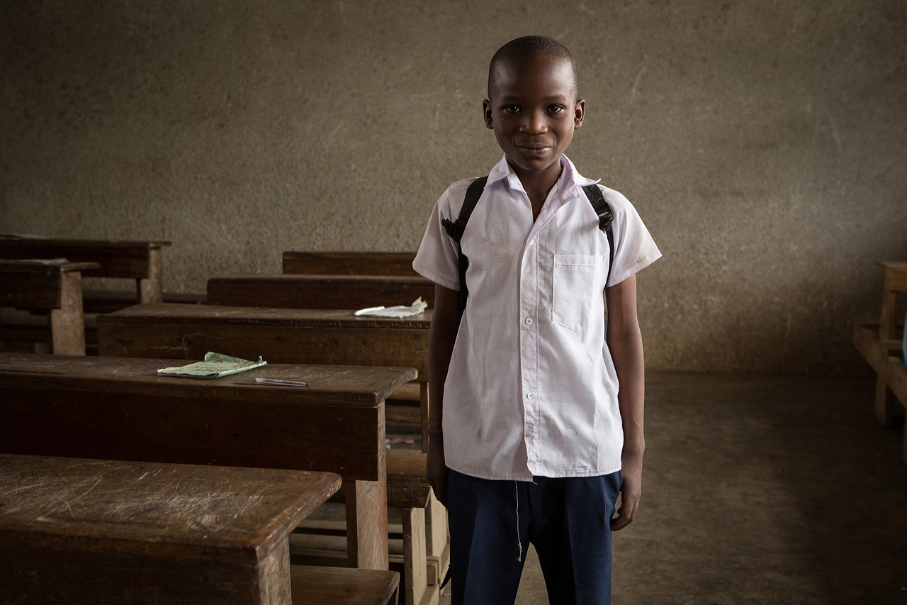
Student Performance Overview
Overview of Academic Progress
Subject Grades and Performance
Key Achievements
The student has demonstrated consistent academic performance across various subjects.
This summary highlights key achievements and areas for improvement.
Mathematics: B+ (Good problem-solving skills).
English Language Arts: A- (Strong writing and comprehension).
Consistently strong performance in a specific subject.
Notable improvement in another subject over the last term.
Performance Metrics
Summary and Recommendations
Science: B (Needs to focus on lab work).
Social Studies: A (Excellent participation).
This overview provides a snapshot of academic strengths.
It also identifies areas to monitor for further development.
4
/
Comprehensive Parent-Teacher Meeting on Student Progress and Collaboration

Slide 5
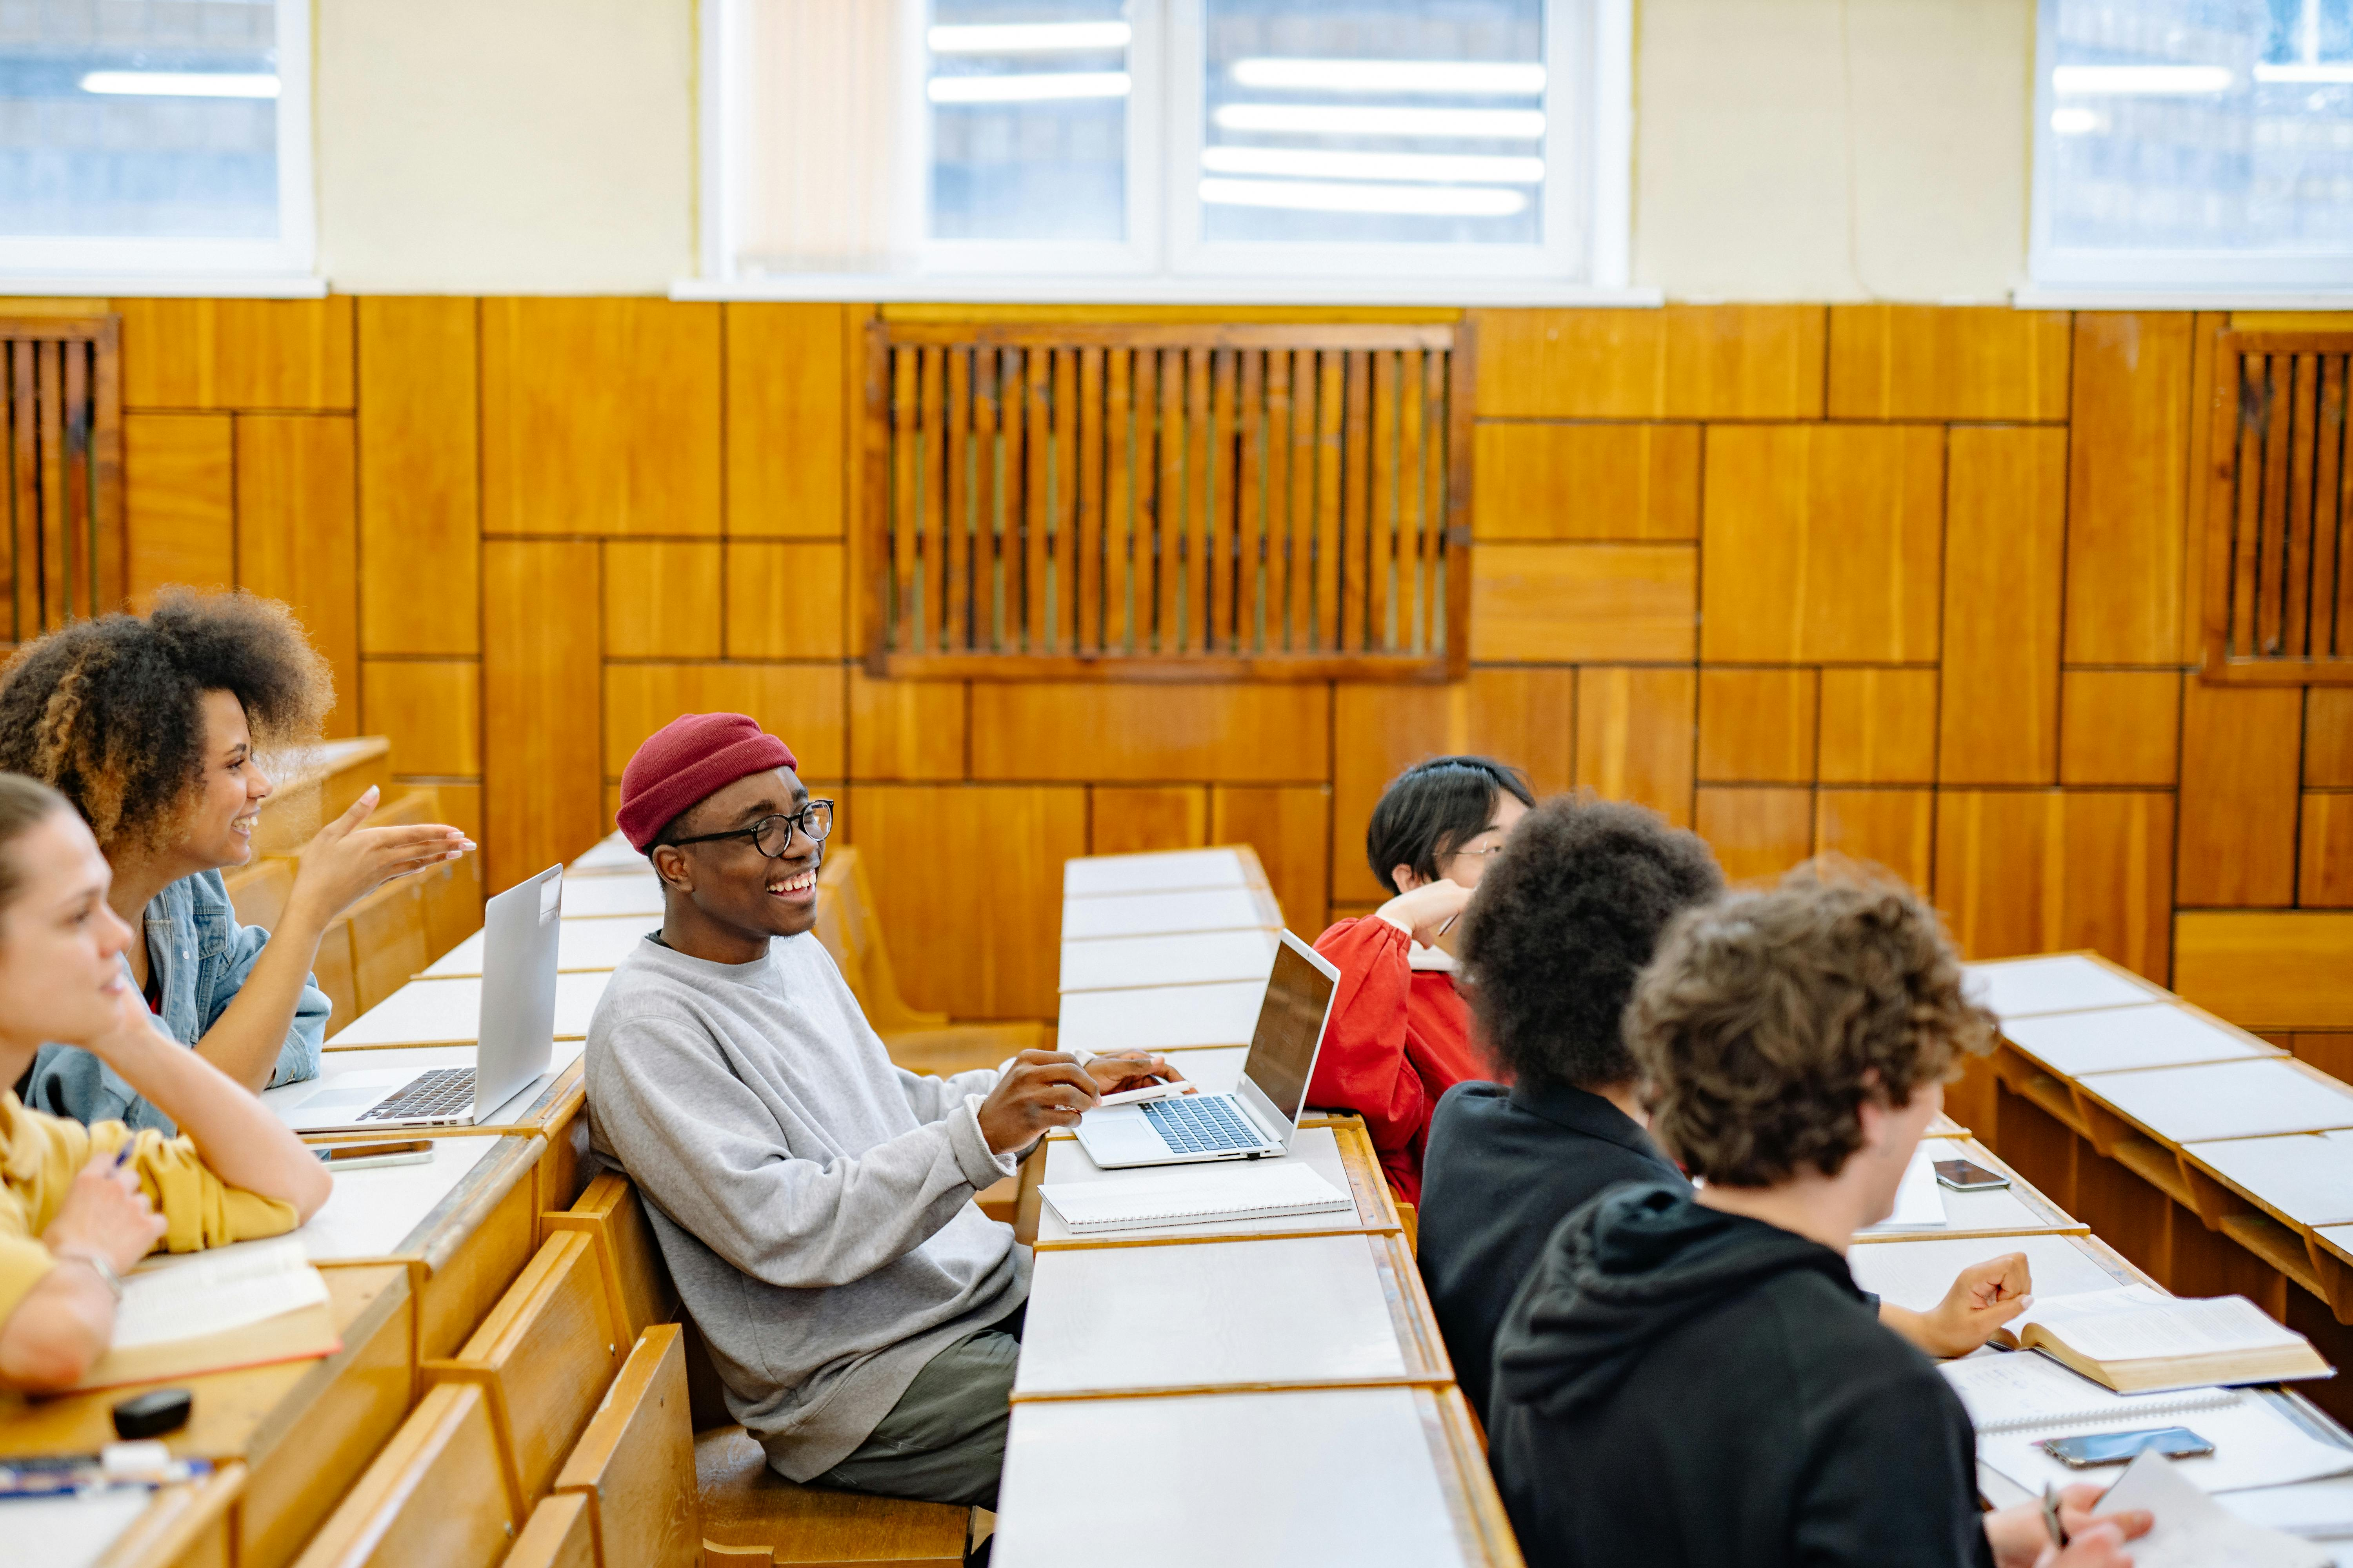
Behavior and Participation
1
2
3
Classroom Behavior
Participation in Discussions
Social Interactions
[Student Name] is generally respectful and attentive in class.
Occasionally, reminders are needed to help [Student Name] stay on task.
[Student Name] actively contributes to class discussions.
They show enthusiasm during group activities.
[Student Name] maintains positive relationships with peers.
They demonstrate empathy and cooperation in social settings.
4
5
Sample Comment on Motivation
Sample Comment on Leadership
[Student Name] is a motivated learner who enjoys collaborating with classmates.
This highlights their engagement and teamwork skills.
[Student Name] shows leadership potential during team projects.
This is evident through their ability to guide and inspire peers.
5
/
Comprehensive Parent-Teacher Meeting on Student Progress and Collaboration

Slide 6

Areas for Improvement
1
2
3
Identified Challenges
Suggested Strategies
Example Action Items
Challenge 1: Time management during assignments.
Challenge 2: Consistency in homework completion.
Implement a daily homework checklist to improve organization.
Encourage reading for 20 minutes daily to enhance comprehension.
Parent to review homework checklist each evening.
Teacher to provide weekly progress updates.
4
5
Student Engagement
Collaborative Efforts
Student to set personal goals for participation.
Provide opportunities for the student to lead small group activities.
Collaborative efforts will support the student in overcoming these challenges.
Focus on teamwork between parents, teachers, and the student.
6
/
Comprehensive Parent-Teacher Meeting on Student Progress and Collaboration

Slide 7
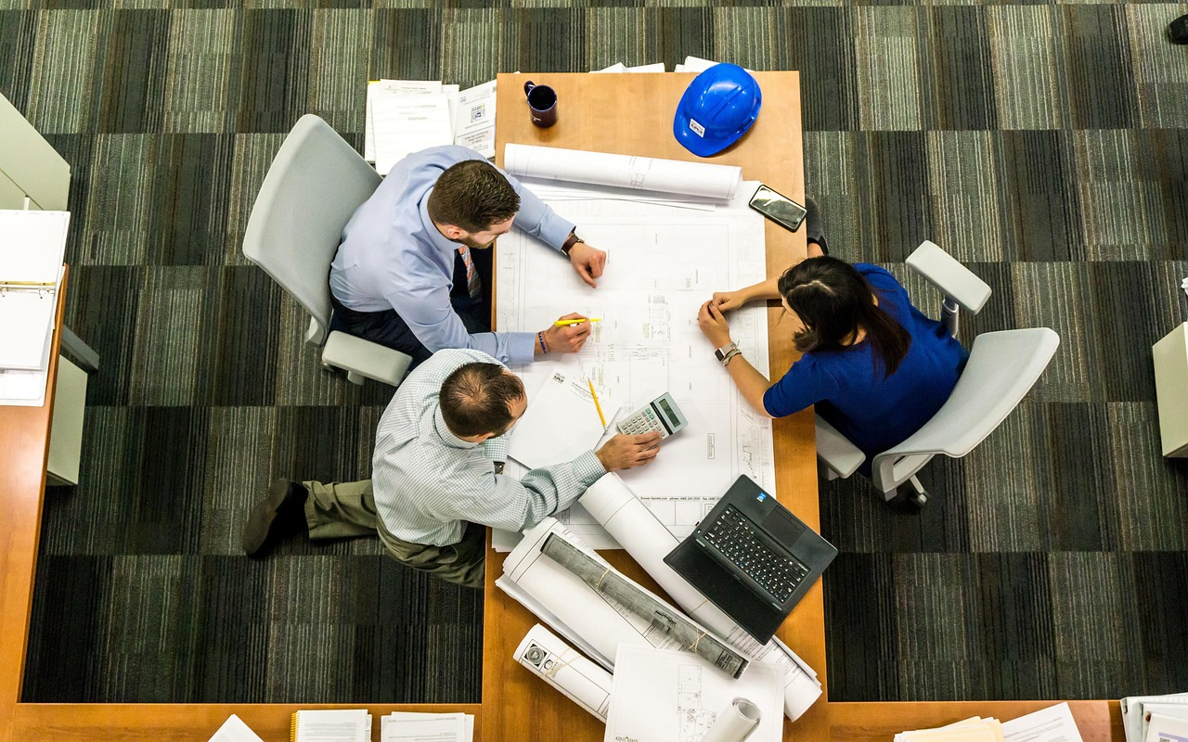
Action Plan and Next Steps
Action Items Overview
Deadlines and Follow-Up
- Schedule weekly check-ins to monitor progress.
- Provide additional resources for math practice.
- Next meeting/follow-up date: [Date].
- Progress review checkpoints: [Dates].
Responsibilities Allocation
Contact Information
- Parent: Support homework routine.
- Teacher: Share feedback on assignments.
- Teacher Email: [Teacher Email].
- Parent Contact: [Parent Contact].
Student's Role
- Student: Complete tasks on time.
- Encourage participation in extracurricular activities.
7
/
Comprehensive Parent-Teacher Meeting on Student Progress and Collaboration

Slide 8

Feedback and Questions
Open Forum for Feedback
Collaboration for Student Success
We invite all participants to share their thoughts, questions, or concerns.
This is an opportunity to discuss and provide valuable input.
We aim to better collaborate to support the student's needs.
Your input is crucial in fostering their success.
Parent and Teacher Feedback
Notes and Responses
We have placeholders for both parent and teacher feedback.
These will be used to document and address specific insights.
Placeholders are available for meeting notes and actionable responses.
These will help in tracking and implementing feedback effectively.
Example Prompts for Discussion
Consider what support would benefit the student most.
Discuss any concerns about the current learning environment.
8
/
Comprehensive Parent-Teacher Meeting on Student Progress and Collaboration

