Slide 1




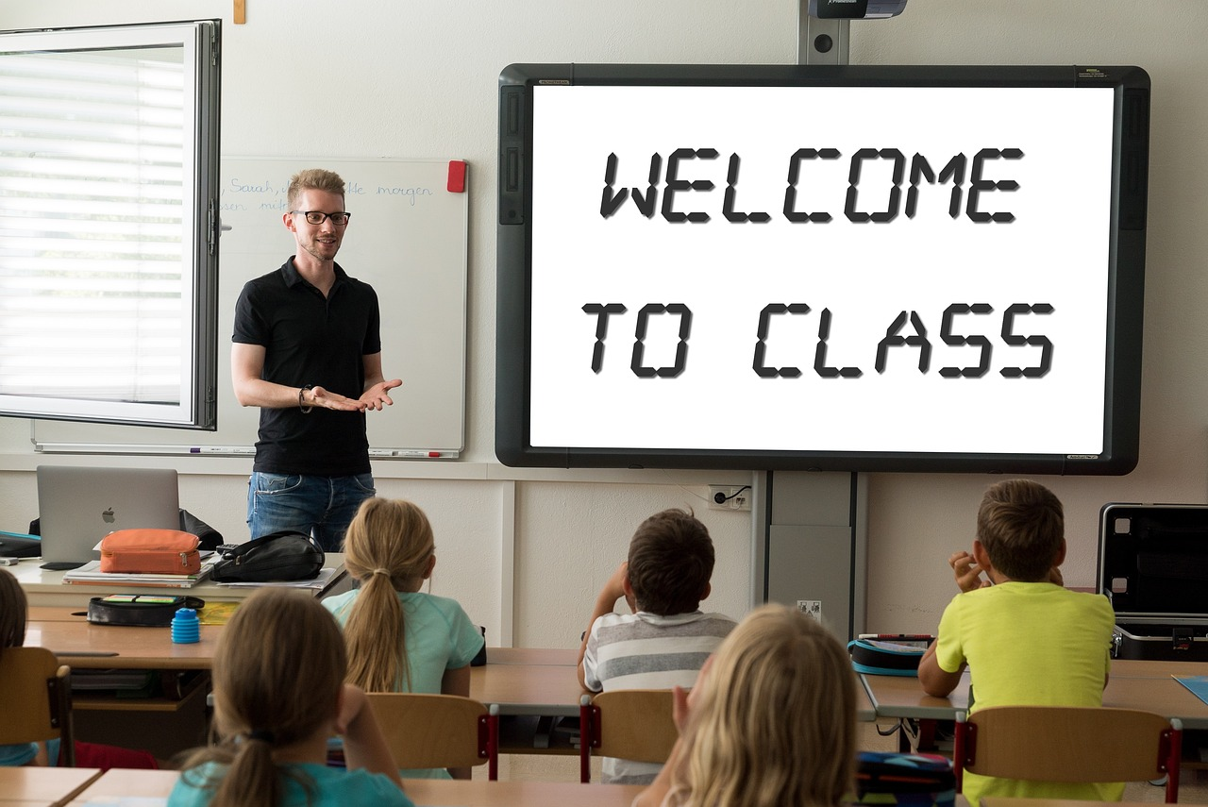
Mastering Descriptions in French: People, Vocabulary, and Grammar
A Comprehensive Guide to Describing Physical Appearance and Personality with Adjective Agreement and Interactive Practice

Slide 2





Table of Contents
Welcome to French Class: Describing People
Key Vocabulary: Describing People
Grammar Focus: Using Adjectives
Example Descriptions
Interactive Activity: Describe a Classmate
Practice Exercise: Fill in the Blanks
Review and Recap
Additional Resources & Next Steps
03
04
05
06
07
08
09
10

Slide 3









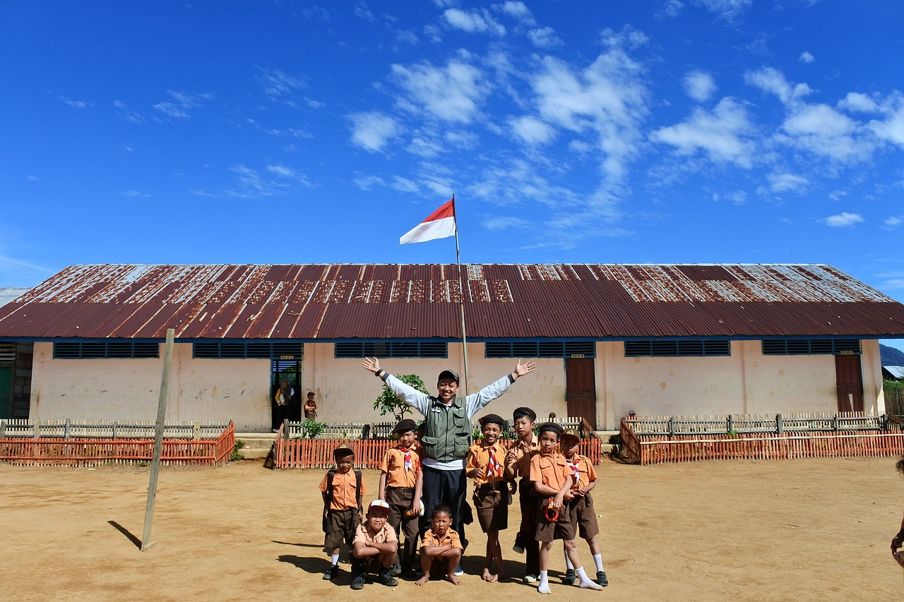
Welcome to French Class: Describing People
Introduction to the Lesson
Class Details
Lesson Objectives
Welcome to today’s lesson on Describing People in French!
This presentation will guide you through essential vocabulary, grammar rules, and fun activities to help you confidently describe people in French.
Teacher: [Your Name]
Date: [Date], Class/Year: Year 8 / [Class Name]
Key vocabulary for physical appearance and personality.
Grammar focus: adjective agreement.
Learning Activities
Encouragement for the Lesson
Sample descriptions to model your own sentences.
Interactive and practice activities to reinforce learning.
Get ready to explore how to talk about people in French.
Approach the lesson with confidence and creativity!
3
Mastering Descriptions in French: People, Vocabulary, and Grammar

Slide 4


Key Vocabulary: Describing People
1
2
3
Introduction to Descriptive Vocabulary
Physical Appearance Adjectives
Examples of Physical Descriptions
This slide introduces key vocabulary for describing people.
It includes terms for both physical appearance and personality traits.
Adjectives such as 'tall', 'blond', and 'short' describe physical traits.
These words help paint a visual picture of a person.
Examples include 'brown-haired' and 'blue-eyed'.
These terms specify distinct features of individuals.
4
5
Personality Traits Adjectives
Examples of Personality Descriptions
Adjectives like 'friendly', 'shy', and 'funny' describe personality.
These words convey the character and behavior of a person.
Examples include 'kind' and 'serious'.
These terms highlight specific personality characteristics.
4
Mastering Descriptions in French: People, Vocabulary, and Grammar

Slide 5
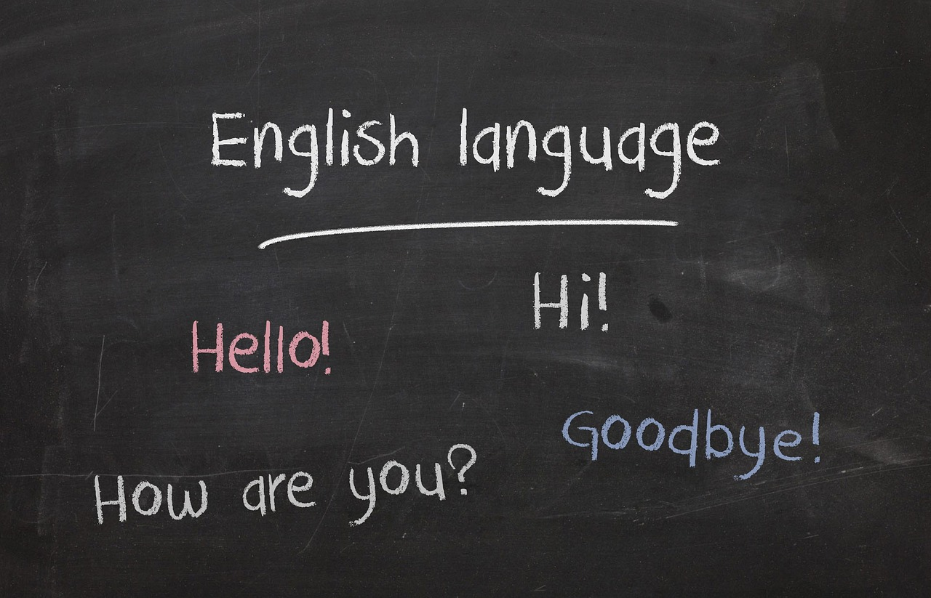
Grammar Focus: Using Adjectives
1
Adjective Agreement in French
4
Examples of Adjective Usage
In French, adjectives must agree in gender (masculine/feminine) and number (singular/plural) with the noun they describe.
This agreement ensures proper grammatical structure and clarity in communication.
For singular subjects: 'Paul est grand' (masculine) and 'Marie est grande' (feminine).
For plural subjects: 'Ils sont gentils' (masculine plural) and 'Elles sont gentilles' (feminine plural).
2
Basic Rules for Adjective Forms
5
Adjusting Adjective Endings
Masculine singular adjectives stay in their base form, such as 'grand'.
Feminine singular adjectives usually add -e, for example, 'grande'.
It is important to modify the adjective ending to match the gender and number of the noun being described.
This adjustment is crucial for accurate and grammatically correct sentences.
3
Plural Forms of Adjectives
Masculine plural adjectives typically add -s, like 'grands'.
Feminine plural adjectives generally add -es, such as 'grandes'.
5
Mastering Descriptions in French: People, Vocabulary, and Grammar

Slide 6






Example Descriptions
Short Description Template
Longer Description Template
Use these sample descriptions as templates.
Replace placeholders with your own details.
Try creating your own descriptions using this structure.
Example: Lucas is 13 years old. He has blond hair and blue eyes.
6
Mastering Descriptions in French: People, Vocabulary, and Grammar

Slide 7


Interactive Activity: Describe a Classmate
Introduction to the Activity
Description Prompts
Objective of the Activity
Let’s practice describing people!
This activity focuses on using prompts to create descriptions of classmates or fictional characters.
Include details such as Name, Physical Trait, and Personality Trait.
Example: '[Classmate's Name] is [physical trait] and [personality trait].'
This activity aims to enhance your skills in speaking and writing about people.
It provides an engaging way to practice language and descriptive abilities.
Activity Instructions
Participation Methods
Choose a classmate or invent a fictional character.
Use the provided prompts to create a detailed description.
Share your description aloud with the class or write it on the board.
Alternatively, pair up and describe each other using French vocabulary and grammar.
7
Mastering Descriptions in French: People, Vocabulary, and Grammar

Slide 8

Practice Exercise: Fill in the Blanks
Introduction to the Exercise
Sentence Completion Task
Customization and Personalization
This exercise is designed to enhance vocabulary and descriptive skills.
Participants will complete sentences by filling in blanks with suitable words.
Participants are provided with sentences containing blanks.
They are encouraged to use adjectives and vocabulary to complete these sentences.
The sentences can be tailored to fit the specific lesson or context.
This allows for a more engaging and relevant learning experience.
Speaking Practice
Creative Sentence Writing
Participants are instructed to practice saying the completed sentences aloud.
This helps improve pronunciation and fluency in French.
Participants are encouraged to create their own fill-in-the-blank sentences.
These can be shared with classmates for additional practice and interaction.
8
Mastering Descriptions in French: People, Vocabulary, and Grammar

Slide 9
Review and Recap
Vocabulary Insights
Grammar Application
Key adjectives to describe physical appearance and personality were introduced.
These terms help in creating vivid and accurate descriptions of individuals.
We explored the use of adjectives with correct gender and number agreement.
This ensures grammatical accuracy in descriptive sentences.
Practical Examples
Interactive Activities
Examples of constructing short and longer descriptions of people were provided.
These examples serve as templates for creating personalized descriptions.
Interactive speaking and writing exercises were conducted to practice describing classmates.
These activities enhance both linguistic and social skills.
9
Mastering Descriptions in French: People, Vocabulary, and Grammar

Slide 10

Additional Resources & Next Steps
Explore Online Resources
Recommended Reading
Engage with Visual Media
To continue improving your skills in describing people in French, explore these resources.
Websites: [Insert website links or names].
Books: [Insert book titles or authors].
These books provide valuable insights and exercises for mastering French descriptions.
Videos: [Insert video titles or channels].
These videos offer practical examples and engaging content to enhance your learning.
Homework Assignment
Upcoming Learning Topics
Write a paragraph describing a family member or friend using today’s vocabulary and grammar.
Prepare to share your description in the next class.
Describing places and objects, talking about daily routines, and using verbs with adjectives.
Feel free to add your own resources and homework ideas to tailor this section!
10
Mastering Descriptions in French: People, Vocabulary, and Grammar

