Slide 1

Embracing Dark Mode in Portfolio Design
Strategies, Benefits, and Best Practices for Creating Stunning Dark Mode Portfolios

Slide 2
Table of Contents
Embracing Dark Mode in Portfolio Design
Understanding Dark Mode
Advantages of Dark Mode in Portfolios
Key Design Principles for Dark Mode Portfolios
Choosing the Right Color Palette
Typography Best Practices in Dark Mode
Adapting Imagery and Media for Dark Backgrounds
Designing Interactive Elements with Accessibil…
Inspiring Examples of Dark Mode Portfolios
Overcoming Common Dark Mode Design Challenges
Practical Tips and Tools for Dark Mode Impleme…
Looking Ahead: The Future of Dark Mode in Port…
03
04
05
06
07
08
09
10
11
12
13
14
Embracing Dark Mode in Portfolio Design

Slide 3

Embracing Dark Mode in Portfolio Design
01
02
03
The Rise of Dark Mode
Significance in Portfolio Design
Enhancing Creative Presentation
Dark mode has rapidly become a preferred interface style among users and designers alike.
Its popularity is driven by its aesthetic appeal and user-friendly nature.
Integrating dark mode into portfolio design emphasizes its growing popularity.
It aligns with current user preferences, making portfolios more engaging.
Dark-themed portfolios enhance the presentation of creative work.
This is achieved through thoughtful design choices that highlight content effectively.
Embracing Dark Mode in Portfolio Design

Slide 4

Understanding Dark Mode
01
02
Definition of Dark Mode
Comparison with Light Mode
Dark mode is a user interface design style.
It features light-colored text and elements on a predominantly dark background.
Unlike traditional light mode, dark mode uses dark text on a light background.
This reduces overall screen brightness and shifts the visual focus.
01
02
Aesthetic Appeal
Functional Benefits
Dark mode creates a distinct aesthetic experience.
It is often perceived as modern and sleek.
The contrast in dark mode provides a functional experience.
It enhances visual focus and reduces screen brightness.
Embracing Dark Mode in Portfolio Design

Slide 5

Advantages of Dark Mode in Portfolios
01
02
03
Reduced Eye Strain
Enhanced Battery Efficiency
Visual Impact
Dark backgrounds with lighter text minimize glare and blue light exposure.
This makes prolonged viewing more comfortable for users.
Dark mode conserves battery life by using less power to illuminate pixels.
This is particularly effective on OLED and AMOLED screens.
Dark mode accentuates colors and images, providing a dramatic backdrop.
This highlights creative content effectively in portfolios.
Embracing Dark Mode in Portfolio Design

Slide 6

Key Design Principles for Dark Mode Portfolios
Color Contrast
Typography Choices
Visual Hierarchy
Ensuring sufficient contrast between text and background is crucial for readability.
This principle helps users comfortably interact with the portfolio in dark mode.
Selecting appropriate fonts and sizes maintains clarity on a dark canvas.
Typography should complement the aesthetic while ensuring legibility.
Organizing content strategically guides the viewer’s eye naturally.
Using lightness and spacing effectively enhances usability in dark mode.
Embracing Dark Mode in Portfolio Design

Slide 7
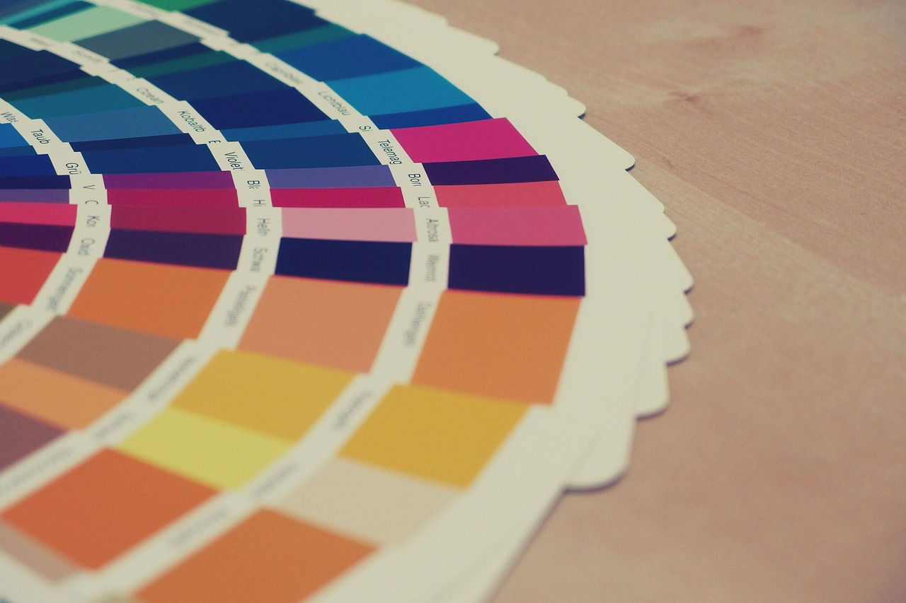
Choosing the Right Color Palette
01
02
Muted Tones for Dark Mode
Strategic Use of Accent Colors
When selecting colors for dark mode, opt for muted tones rather than pure black.
This approach reduces harshness and enhances visual comfort.
Use accent colors sparingly to draw attention effectively.
This prevents visual fatigue and maintains a balanced design.
03
04
Avoid Bright and Saturated Hues
Achieving a Balanced Palette
Overly bright or saturated hues can create discomfort.
Such colors may also reduce legibility in dark mode settings.
A balanced palette supports both comfort and visual interest.
This ensures a visually appealing and user-friendly experience.
Embracing Dark Mode in Portfolio Design

Slide 8

Typography Best Practices in Dark Mode
01
Font Selection for Readability
Effective typography in dark mode portfolios involves choosing clean, sans-serif fonts.
These fonts provide modernity and enhance readability in low-light conditions.
02
Optimal Font Size
Maintaining adequate font size is crucial to prevent strain on the eyes.
This ensures that text remains accessible and comfortable to read.
03
Contrast for Visibility
Using high contrast between text and background enhances legibility.
Off-white or light gray text on dark surfaces is recommended for a balanced visual experience.
04
Avoiding Glare
Avoiding pure white text reduces glare and improves reading comfort.
This practice contributes to a visually harmonious and user-friendly design.
Embracing Dark Mode in Portfolio Design

Slide 9

Adapting Imagery and Media for Dark Backgrounds
Optimizing Visuals for Dark Mode
Enhancing Image Separation
Maintaining Clarity in Motion Media
Images and media should be carefully selected or edited to complement dark mode.
Use visuals with balanced brightness and contrast to avoid appearing washed out or overly dark.
Consider adding subtle glows or outlines to separate images from the background.
This technique ensures that visuals stand out without disrupting the dark theme.
Videos and animations should maintain clarity without overwhelming the dark interface.
This approach preserves impact while integrating seamlessly with the dark theme.
Embracing Dark Mode in Portfolio Design

Slide 10

Designing Interactive Elements with Accessibility in Mind
01
Importance of Color Contrast
Interactive components such as buttons and links must be clearly distinguishable through color contrast and visual cues.
This ensures that users can easily identify and interact with these elements.
02
Appropriate Sizing for Interaction
Interactive elements should be sized appropriately for easy interaction.
This design consideration enhances usability for users with varying physical abilities.
03
Adherence to Accessibility Standards
Designing interactive components to meet accessibility standards ensures usability for all users.
This includes considerations for individuals with visual impairments.
04
Enhancing User Experience
Thoughtful design of interactive elements enhances user experience.
This approach promotes inclusivity and accessibility in digital interfaces.
Embracing Dark Mode in Portfolio Design

Slide 11

Inspiring Examples of Dark Mode Portfolios
01
Balancing Aesthetics and Functionality
Several portfolios stand out for their effective use of dark mode by balancing aesthetics with functionality.
This approach ensures that the design is visually appealing while maintaining usability.
02
Consistent Color Schemes and Typography
Employing consistent color schemes and typography is a hallmark of successful dark mode portfolios.
This consistency enhances the overall coherence and professionalism of the presentation.
03
Enhanced Visual Emphasis for Creative Work
Showcasing creative work with enhanced visual emphasis is a key advantage of dark mode.
These case studies demonstrate how this feature can elevate portfolio presentation and inspire innovative design solutions.
Embracing Dark Mode in Portfolio Design

Slide 12

Overcoming Common Dark Mode Design Challenges
1
2
3
Challenge: Insufficient Contrast
Challenge: Overuse of Bright Colors
Challenge: Media Adaptation Difficulties
Insufficient contrast in dark mode designs can lead to poor readability.
This issue requires careful attention to text and background color combinations to ensure accessibility.
Bright colors in dark mode can cause eye fatigue for users.
Designers should limit the use of vibrant hues and opt for muted tones to enhance comfort.
Adapting media for dark backgrounds can be challenging.
Ensuring images and videos are optimized for visibility in dark mode is essential.
4
5
Solution: Rigorous Testing
Solution: Careful Palette Selection
Rigorous testing of dark mode designs helps identify and resolve usability issues.
This process includes evaluating contrast, color usage, and media integration.
Selecting an appropriate color palette is crucial for effective dark mode design.
Designers should prioritize colors that maintain readability and reduce eye strain.
Embracing Dark Mode in Portfolio Design

Slide 13
Practical Tips and Tools for Dark Mode Implementation
01
02
03
04
Frameworks and Libraries for Theme Toggling
Design Tools with Dark Mode Preview
CSS and UI Component Best Practices
Streamlining Development and Design Quality
Utilize frameworks and libraries that support theme toggling.
These tools simplify the implementation of dark mode in portfolios.
Employ design tools with dark mode preview capabilities.
Previewing designs in dark mode ensures visual consistency and quality.
Follow best practices for CSS and UI components to maintain consistency.
Consistent styling enhances user experience across themes.
These resources streamline development and enhance design quality.
Efficient tools and practices contribute to professional portfolio presentation.
Embracing Dark Mode in Portfolio Design

Slide 14

Looking Ahead: The Future of Dark Mode in Portfolios
01
Personalization and Adaptive Themes
Dark mode is evolving to offer greater personalization options.
Adaptive themes will allow portfolios to dynamically adjust to user preferences.
02
Integration with Emerging Technologies
Future trends include the integration of dark mode with new display technologies.
These advancements will enhance the visual experience for portfolio users.
03
Enhanced Accessibility Features
Dark mode will incorporate improved accessibility features.
This ensures portfolios remain inclusive and user-friendly for all audiences.
Embracing Dark Mode in Portfolio Design

